Slide 1
Lecture 05: Problem Solving

Slide 2
Objectives
Basic concepts of problem solving
Steps involved in program development
Top-down programming
Programming languages, their types, and features

Slide 3
Problem Solving
It’s a creative process, it is an act of
Defining a problem
Determining the cause of the problem
Identifying, prioritizing, and selecting alternative for a solution
Implementing a solution

Slide 4
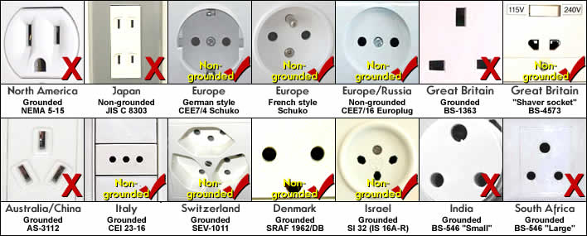




Problem Solving

Slide 5
Strategies for problem solving
There is no universal method for solving a given problem
Different strategies are good for different problems
Some of the well-known strategies are
Divide and conquer
Greedy method
Dynamic programming
Backtracking
Branch and Bound
Notes:
Divide and conquer: E.g., recursive fibonacci
A greedy algorithm is a mathematical process that looks for simple, easy-to-implement solutions to complex, multi-step problems (so no overlapping subproblems, e.g., solving one subproblem doesn’t help much in solving other subproblems) by deciding which next step will provide the most obvious benefit.
Dynamic programming is a method for solving a complex problem by breaking it down into a collection of simpler subproblems (subproblems can be overlap, one subproblem can use another subproblem e.g., recursive Fibonacci but could also remember previous fibo calculated, so, if it is in the memories -> don’t do recursive anymore), solving each of those subproblems just once, and storing their solutions - ideally, using a memory-based data structure.
Backtracking is a general algorithm for finding all (or some) solutions to some computational problems, notably constraint satisfaction problems, that incrementally builds candidates to the solutions, and abandons each partial candidate c ("backtracks") as soon as it determines that c cannot possibly be completed to a valid solution
Branch and bound vs. Backtracking: Backtracking finds all optimal solutions, Branch and bound
Divide and conquer vs. Dynamic programming: http://stackoverflow.com/questions/13538459/difference-between-divide-and-conquer-algo-and-dynamic-programming
Greedy algorithm vs. Dynamic programming: http://stackoverflow.com/questions/13713572/how-is-dynamic-programming-different-from-greedy-algorithms
Divide and conquer vs. greedy algorithm: Divide an conquer will give optimal solution (may revise its decision), greedy algorithm (will not revise its subproblems optimization, it will just optimize its subproblems and hopefully the overall problem will be good).

Slide 6
Steps in Program Development
The various steps involved are
Defining or Analyzing the problem
Design (Algorithm)
Coding
Documenting the program
Compiling and running the program
Testing and Debugging
Maintenance

Slide 7
Analyzing or Defining the Problem
The problem is defined by doing a preliminary investigation
Defining a problem helps us to understand problem clearly
It is also known as Program Analysis

Slide 8
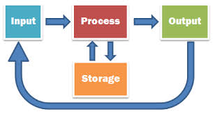
Tasks in defining a problem
Followings are the tasks in order to define a problem
Specifying the input requirements
Specifying the output requirements
Specifying the processing requirements

Slide 9
Specifying the input requirements
The input specification is obtained by answering following questions
What specific values will be provided as input to the program?
What format will the values be?
For each input item, what is the valid range of values that it may assume?
What restrictions are placed on the use of these values?

Slide 10
Specifying the output requirements
The output specification is obtained by answering the following questions
What values will be produced?
What is the format of these values?
What specific annotation, headings, or titles are required in the report?
What is the amount of output that will be produced?

Slide 11
Specifying the processing requirements
The processing requirement is obtained by answering following questions
What is the method (technique) required in producing the desired output?
What are the validation checks that need to be applied to the input data?
What calculations are needed?

Slide 12
Activity: Find Factorial Number
Input?
Output?
Process?

Slide 13
Activity Find Factorial Number
Input: Positive integer number
Output: Factorial of that number
Process: Solution technique which transforms input to output. Factorial of a number can be calculated by the formula n!=1*2*3*…*n

Slide 14
Use-case diagram
Use case diagrams are used to gather the requirements of a system
So when a system is analyzed to gather its functionalities use cases are prepared and actors are identified.
The purposes of use case diagrams can be as follows:
Used to gather requirements of a system
Used to get an outside view of a system
Identify external and internal factors influencing the system
Show the interacting among the requirements are actors
Notes:
Can use https://www.draw.io to draw

Slide 15
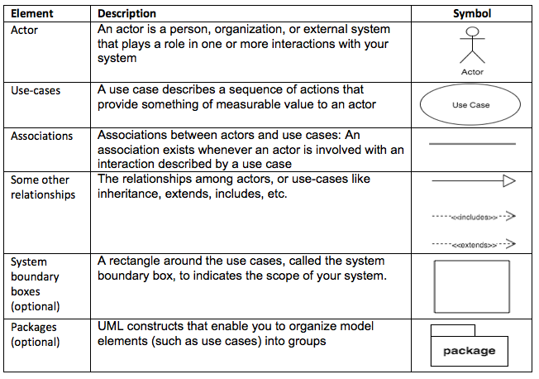
Main elements of use-case diagram

Slide 16
Activity: Draw use-case diagram
You are hired to develop FAI’s library system with following description
Admin who could
Manage books, readers (staff, lecturers, and students), etc.
Manage borrow/return books
Users (staff, lecturers, students) who could
View/search books
Reserve books
Borrow/return books
Please draw Use-case diagram for this scenario

Slide 17
Design
A design is the path from the problem to a solution in code
The well designed program is likely to be:
Easier to read and understand later
Less of bugs and errors
Easier to extend to add new features
Easier to program in the first place

Slide 18
Modular Design
Once the problem is defined clearly, several design methodologies can be applied
An important approach is Top-Down program design
It is structured design technique
It breaks up the problem into a set of sub-problems called Modules
It creates a hierarchical structure of the modules

Slide 19
Developing a solution technique: Algorithm
An algorithm is a step-by-step description of the solution to a problem
An algorithm must be
Definite
Finite
Precise and Effective
Implementation independent (only for problem not for programming languages)

Slide 20
Activity: Find factorial number
Please list the steps inside an algorithm to find factorial number of a positive integer

Slide 21
Activity: Find factorial number
Step 1: Start
Step 2: Initialize factorial to be 1, i to be 1
Step 3: Input a number n
Step 4: Check whether the number is 0. If so report factorial is 1 and go to step 9
Step 5: Repeat step 6 through step 7 n times
Step 6: Calculate factorial = factorial * i
Step 7: Increment i by 1
Step 8: Report the calculated factorial value
Step 9: Stop

Slide 22
Pseudo Code
Pseudo code is an informal high-level description of an algorithm
It uses the structural conventions of programming languages, but
It omits language-specific syntax
It is an outline of a program written in English or the user’s natural language

Slide 23
Example 3: Pseudo code for factorial number
Step 1: START
Step 2: DECLARE the variables n, fact, i
Step 3: SET variable fact=1 and i=1
Step 4: READ the number n
Step 5: IF n=0 then
Step 5.1: PRINT factorial = 1
Step 5.2: GO TO Step 10
Step 6: WHILE i <= n is true, repeat Step 7 through Step 8
Step 7: COMPUTE fact = fact * i
Step 8: INCREMENT i by 1
Step 9: PRINT the factorial value
Step 10: STOP

Slide 24
Flowchart
Flowchart is a diagrammatic representation of an algorithm
It uses different symbols to represent the sequence of operations, required to solve a problem
It serves as a blueprint or a logical diagram of the solution to a problem

Slide 25
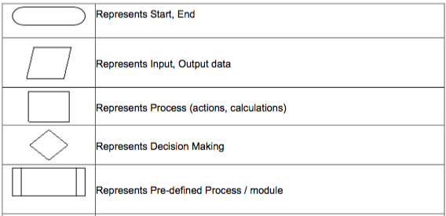
Flowchart symbols (1/2)

Slide 26
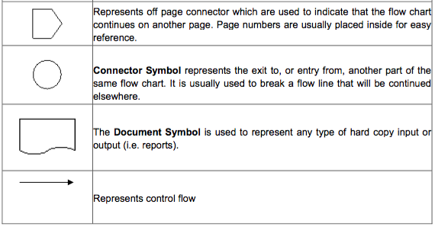
Flowchart symbols (2/2)
Notes:
Can use https://www.draw.io to draw

Slide 27
Activity: Drawing flowchart
Draw a flowchart for the algorithm to find factorial number in previous activity

Slide 28
Coding
An algorithm expressed in programming languages is called Program
Writing a program is called Coding
The logic that has been developed in the algorithm is used to write program

Slide 29
Documenting the Program
Document explains
How the program works and how to use the program (user manual)
How to maintain the program (developer manual)
Details of particular programs, or particular pieces of programs, are easily forgotten or confused without suitable documentation

Slide 30
Forms of documentation
Documentation comes in two forms
External documentation, which includes things such as reference manuals, algorithm descriptions, flowcharts, and project workbooks
Internal documentation, which is part of the source code itself (essentially, the declarations, statements, and comments)

Slide 31
Compiling and Executing the Program
Compilation is a process of translating a source program into machine understandable form
The compiler is system software
It examines each instruction for its correctness
It does the translation
During the execution
Program is loaded into the computer’s memory
The program instructions are executed

Slide 32
Testing
Testing is the process of executing a program with the deliberate intent of finding errors
Testing is needed to check whether the expected output matches the actual output
Testing is done during every phase of program development
Initially, requirements can be tested for its correctness
Then, the design (algorithm, flow charts) can be tested for its exactness and efficiency
Structured walk through is made to verify the design

Slide 33
Test criteria
Programs are tested with several test criteria and the important ones are given below
Test whether each and every statement in the program is executed at least one (Basic path testing)
Test whether every branch in the program is traversed at least once (control flow)
Test whether the input data flows through the program and is converted to an output (data flow)

Slide 34
Significant test cases
Significant test cases increase the possibility to discover errors
It is important to design test cases for abnormal input conditions
The boundary (or extreme) cases
The unusual cases
The invalid cases

Slide 35
Debugging
Debugging is a process of correcting the errors
Programs may have logical errors which cannot be caught during compilation
Debugging is the process of identifying their root causes
One of the ways is to print out the intermediate results at strategic points of computation
Another way is to use support from the IDE
Testing vs Debugging
Testing means detecting errors
Debugging means diagnosing and correcting the root causes

Slide 36
Maintenance
Program maintenance
Continuing process of maintenance and modification
To keep pace with changing requirements and technologies
Maintainability of the program is achieved by
Modularizing it
Providing proper documentation for it
Following standards and conventions (naming conventions, using symbolic constants, etc.)

Slide 37
What is a Programming Language?
It is an art of making a computer to do the required operations
By means of issuing sequence of commands to it
It can be defined as
A vocabulary (unique set of characters/keywords)
A set of grammatical rules (syntax)
The term programming languages usually refers to high-level languages
E.g., BASIC, C, C++, COBOL, FORTRAN, Ada, and Pascal

Slide 38
Types of programming languages
There are two major types of programming languages
Low level languages (LLL)
High level languages (HLL)

Slide 39
Types of programming languages
Programming Languages
Low Level Languages
Machine Language
Assembly Language
High Level Languages
Numerical languages
Business languages
Artificial Intelligence languages
Systems languages
E.g., early age of computers
E.g., COBOL
E.g., LISP, PROLOG, SNOBOL
E.G., CPL, BCPL
Notes:
Early age of computing is for ELECTRONIC CALCULATORS
COBOL: Common Business Oriented Language
CPL: Combined Programming Language (and Cambridge Programming Language before that)
BCPL: Basic Combined Programming Language

Slide 40
What makes a good language?
Every language has its strengths and weaknesses
FORTRAN is good for numeric data but not good to organize large program
PASCAL is good for structured and readable programs, but it is not as flexible as C
C++ has powerful object-oriented features, but it is complex and difficult to learn
The choice of PL depends on type of the computer used, type of program, and the expertise of the programmer

Slide 41
Criteria of efficient/easy to use
Following are the most important features that would make a programming language efficient and easy to use:
Clarity, simplicity and Unity
Orthogonality
Naturalness for the application
Support for abstraction
Portability of Programs
Cost of use
Cost of Program Maintenance
Notes:
Clarity, simplicity, unity: Written, tested and maintained with ease
Orthogonality (perpendicular): being able to combine features and they are still useful (make it less special cases/exceptions to remember)
Naturalness for the problem: should provide data structures, operations, control structures and natural syntax for the problem to be solved
Support for abstraction: programming has built-in data structures and operations, however, can’t satisfy all needs -> so should allow programmers to define abstract data structures + operations to suit their programming needs (abstraction)
Cost of use: cost of program execution (performance), program creation: design, code, test, usage and maintenance.

Slide 42


Host/Target Environments
Programming on Host Environment:
The environment under which a program is designed, coded, tested & debugged
Operating on Target Environment
The external environment which supports the execution of a program Target
Hello.c
Hello.exe
Hello.exe
Notes:
Batch-processing: For example, the backup process on an organization. The transaction details of all the departments are collected for backup at one place and the backup is done at a time at the end of the day.

Slide 43
Procedural programming
Procedural programming is a programming paradigm
Derived from structured programming
Based on the concept of procedure call
Structured programming
All programs are built from control structures
Control structures: sequence, selection, iteration, recursion
Procedures (routines, subroutines, functions)
Contain a series of computational steps
A procedure can be called at any point during the program execution, including itself (recursion) or other procedures
Procedural programming languages include C, Go, Fortran, Pascal, and BASIC, etc.
Notes:
Structured programming: Programming has structures and built by blocks (control structures). Control structures like: sequence, selection, iteration, recursion

Slide 44
Procedures and modularity
Modularity is generally desirable, especially in large, complicated programs
Inputs are usually in the form of arguments and the outputs delivered as return values
A = 3
ADD
C = 7
B = 4

Slide 45
Procedures and modularity
Scoping is another technique that helps keep procedures modular
It prevents the procedure from accessing the variables of another procedures
A = 3
X = A;
Y = B;
C = A + B;
C = 7
B = 4
X

Slide 46

Procedures and modularity
It has the ability to specify a simple interface, to be self-contained, and to be reused
Procedures are a convenient vehicle for making pieces of code written by different people or different groups, including through programming libraries

Slide 47
Imperative vs Declarative
Procedural programming language is also imperative languages
They give commands to instruct computer to do things
They describe how computer should do things
Declarative programming languages like SQL just explain what should be done
for (i = 0; i < n; i++)
{
if (a[i] == x) {
printf(“found”);
break;
}
}
SELECT name from STUDENT
WHERE id = ‘001’;

Slide 48
Summary
Program development life cycle
Top-down program design
Algorithms
Programming languages
Low Level Languages/High Level Languages
Programming environments
Characteristics and features of Procedural Programming Language

